Slide 1
Smart Home Project
Management Report
Marcelo Jimenez

Slide 2
Objective
To find evidence to help support marketing claims of sub-meters providing owners with 'useful' power usage analytics.
Perform an analytical deep dive of sub-metering generated data and producing high quality visualizations that support a positive narrative around the findings.

Slide 3
Submeters
Energy sub-metering 1 = kitchen (dishwasher, oven, microwave)
Energy sub-metering 2 = laundry room (washing machine, tumble drier, refrigerator, light)
Energy sub-metering 3 = electric water heater and Air Conditioner.

Slide 4
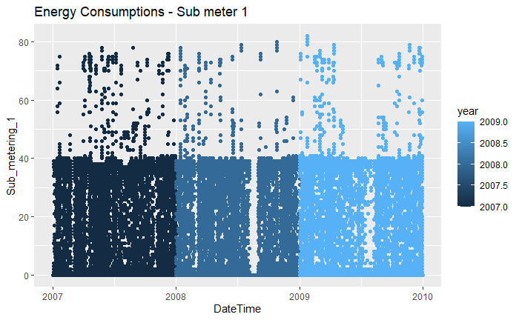
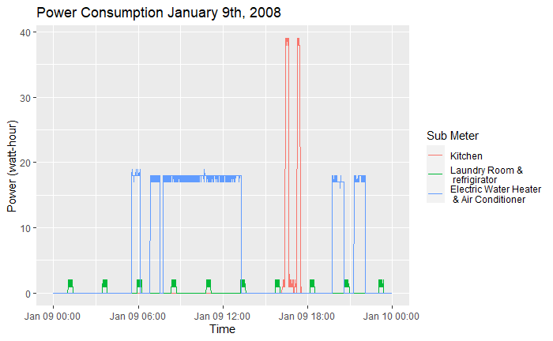
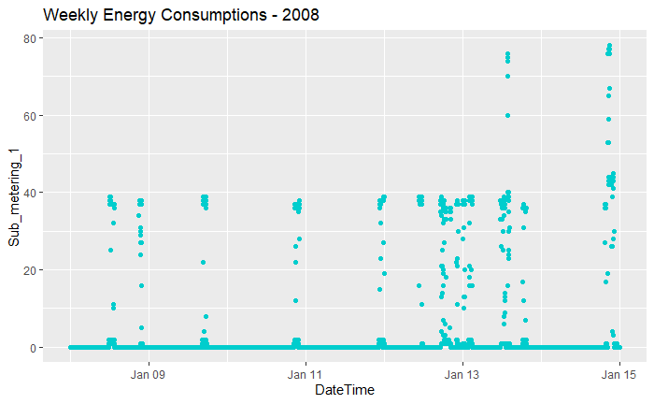
Initial Visualizations

Slide 5
Initial Visualizations
The first few figures show the power consumption throughout all 3 years, a single week, and a single day.
The single day graph allows us to see the cycles at which each submeter reads power consumption. This depends on the frequency use of the devices connected and amount of energy needed for the job. Ex, a single large spike is observed in the kitchen submeter in the middle of the day whereas multiple smaller spikes are observed throughout the day when the freezer goes through frosting cycles.

Slide 6
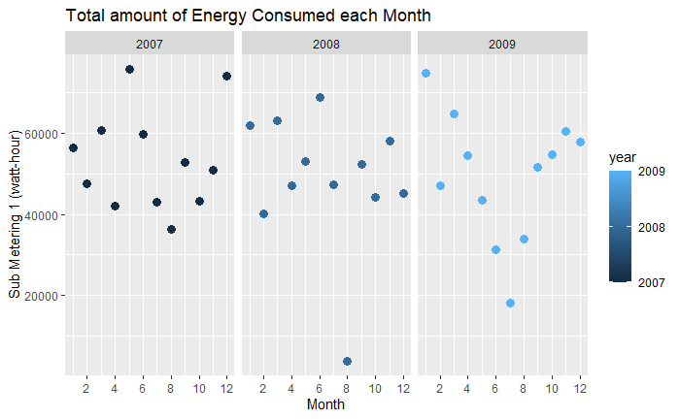
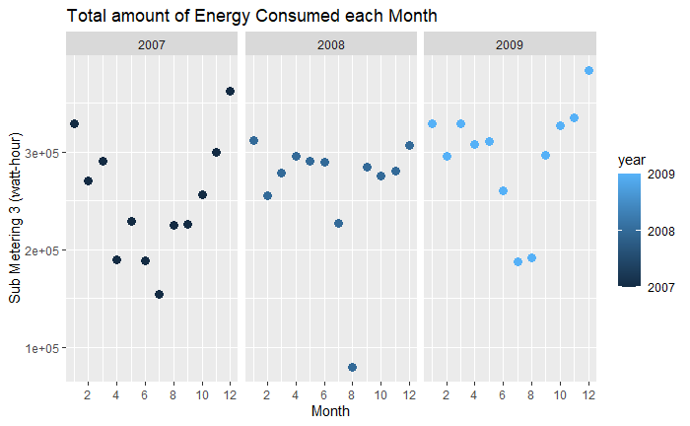
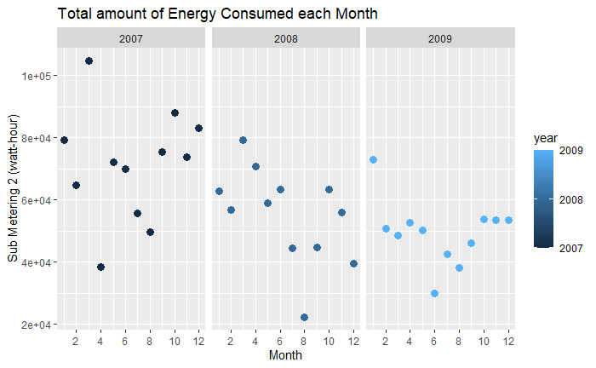
Initial Visualizations

Slide 7
Initial Visualizations
These next set of visualizations take the average consumption of each submeter over each month in the span of 3yrs.
This allows me to see patterns as the months and years go by.
Ex. Submeter 3 which is incharge of heating and cooling varies as the seasons change having the lowest amount of energy consumption in the hot days of summer. But you can also observe a general upward trend in the energy consumption as the years go by, which could be useful when trying to plan for future energy consumption budgets.

Slide 8
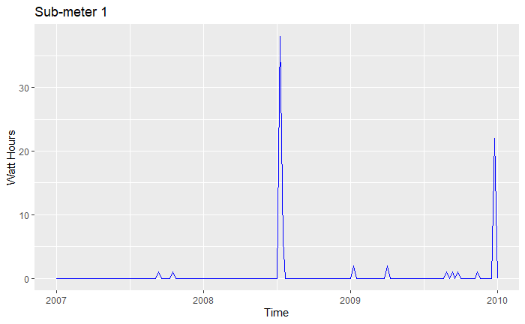
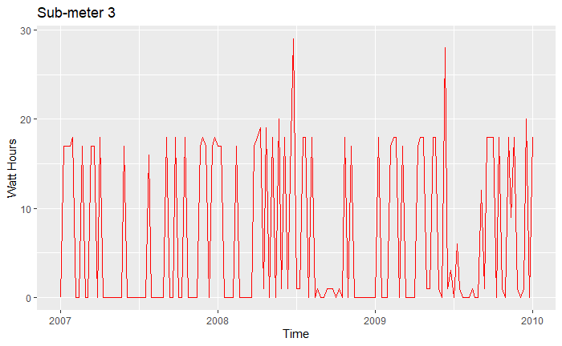
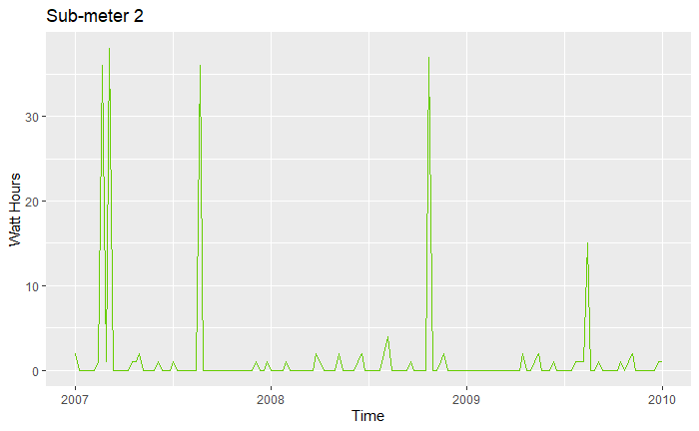
Time Series Visualizations

Slide 9
Time Series Visualizations
Just like my graph before, these set of graphs take the average consumption of each submeter over the span of 3yrs, however these are weekly averages.
To take this averages, data is sampled, in this case, every Monday at hour 20 minute 1. This massively affects the look of these graphs. On a different time of day where the washer might be running, or when the kitchen is not in use, could alter how much energy is recorded.
So, one has to be careful when considering these graphs for analysis.
Nevertheless, this proves a useful tool when trying to manage the energy consumption. As after analysis, it can show what day of the week and at what time the most energy is consumed.

Slide 10
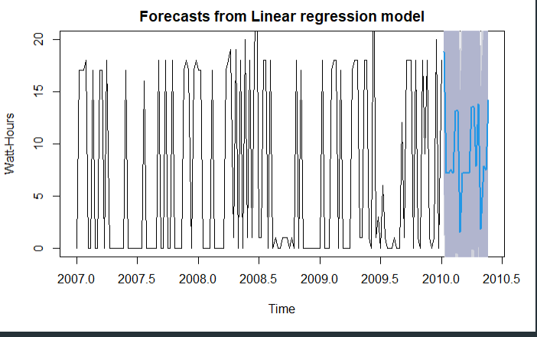
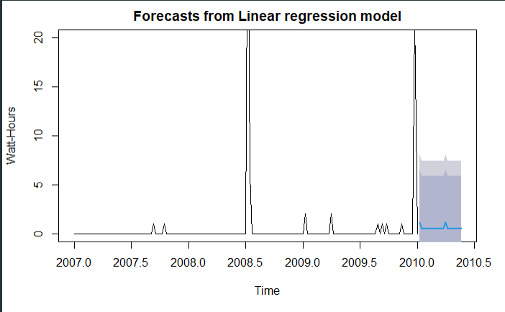
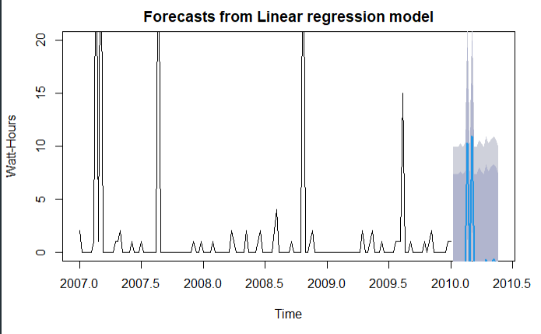

Linear Regression Forecast Visualizations

Slide 11
Linear Regression Forecast Visualizations
When considering time series data, we can do several predictions and try to forecast future trends. These next set of graphs are meant to try to predict the future energy consumption of each submeter over the course of the year.
The blue line is the most probable forecast, with the gray areas as uncertainty parameters. Meaning the actual reading could be anywhere within the gray area.
For our purposes, this could be a useful tool after cleaning up/selecting the data as it provides an idea of future energy consumption trends.

Slide 12
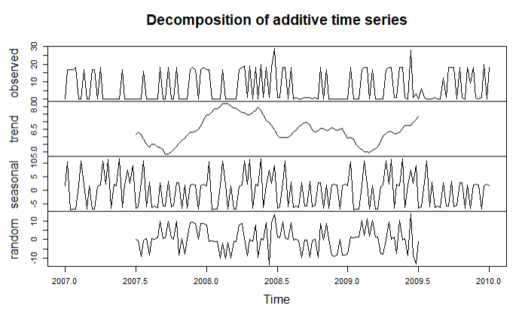
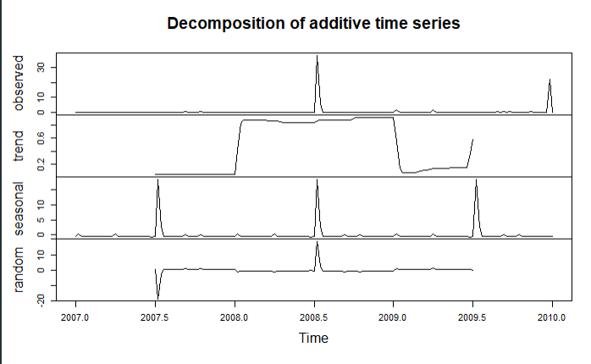
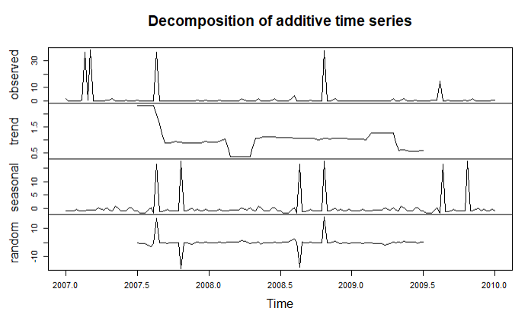
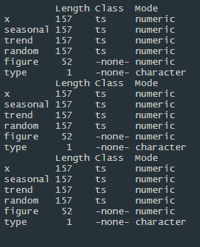
Decomposition Visualizations
Submeter 1
Submeter 3
Submeter 2

Slide 13
Decomposition Visualizations
These visualizations allow for seasonal adjustment when wanting to analyze the trend of the time series independently from the seasonal components. Submeter 3 shows the most seasonality from the three as seen in the decomposition graph.
The graphs are divided into seasonal, trend and random components (with the original ‘observed’ component at the top of each graph)
Submeter 3 has a strong seasonality component since it varies with the temperature outside throughout the year.
The last comparison chart shows the summary statistics from the components from each submeter.
This type of data allows the user to know whether the increase in energy consumption is due to lack of management or just a seasonal increase.

Slide 14
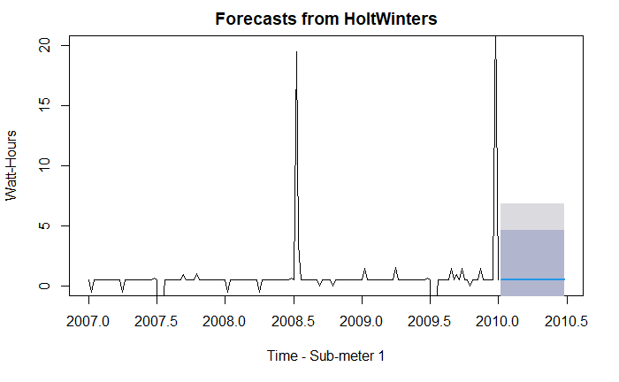
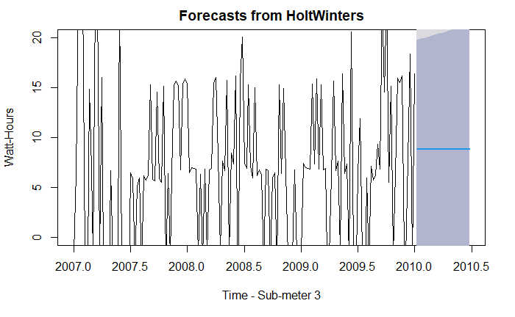
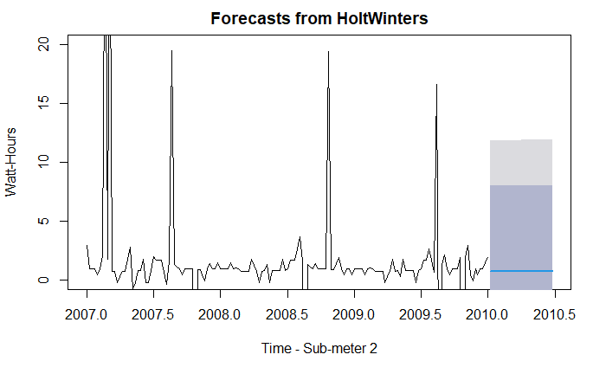
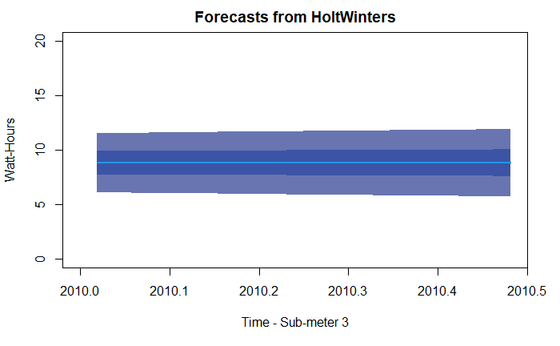
Holt-Winters Forecasting

Slide 15
Holt-Winters Forecasting
These plots are similar to linear regression forecasting, however these use exponential smoothing and neglect any seasonal component.
This is supposed to be a better forecast as it accounts for external factors that may affect the data such as seasonality, but the resultant forecast for all submeters ended up being a straight line.
Very little information can be retrieved from this type of graph, but it can be used as a guideline when trying to plan for future budgets, and try to find energy saving solutions.

Slide 16
Summary Statement
In conclusion, there is evidence to help support marketing claims of sub-meters providing owners with 'useful' power usage analytics. The many visualizations are easier to understand and follow for users to adjust and manage their power usage.
The High-quality visualizations that I outlined in this presentation support a positive narrative towards the data gathering and submetering analysis.

Slide 17
Business recommendations
First, separate the heater and air conditioner into two different submeters. This will give the user a more detailed and useful data analysis. It could be used to better manage the temperature control of the home.
Second, an outside temperature reading would be useful as it could allow the user to check whether he wants certain appliances turned on. Ex. Using the water heater on hot summer days.
Third, allowing the submeters to change power delivery throughout the day might be a good idea for some cases. Ex. Allowing a submeter to limit power delivery of the air conditioner when no one is at home.

Slide 18
Lessons learned
Though having multiple data points over a long period of time is useful, the context is more important. Being able to track exactly what you want and make sense of the data should always be the aim of any data analytics project.
R and ggplot are useful tools that accommodate many different types of data and allow anyone to make predictions.
These predictions can be further improved by careful data selection and cleaning, such as ignoring the effects of seasonal data.
Furthermore, the ability to do sampling and data selection over a period of time is useful, as long as the data analytics expert takes the time variations into account.

